Slide 1
Mobile browser testing using appium
NAME : P BHANU PRAKASH
REG NO: 192011312
Course code: CSA3731
Course Name: SOFTWARE TESTING
Date: 31/01/2023

Slide 2
OBJECTIVE
Testing helps in evaluating and accessing the features, analysing the results of the browser and accuracy of Searching.

Slide 3
ABSTRACT
APPIUM is a freely distributed open source mobile application UI testing framework. Appium allows native, hybrid and web application testing and supports automation test on physical devices as well as an emulator or simulator both.
It offers cross-platform application testing, i.e. single API works for both Android and iOS platform test scripts.
Browser’s becoming the key role to this generation. It uses some search engines and many SEO tools. Sometimes we will not get the accurate results while searching for anything in the browser.
This project is based on the mobile browsers and testing them for errors and inaccuracy.
We uses Appium tool for testing this Mobile Browser application.

Slide 4
PROPOSED WORK
Installing Android Studio and APPIUM applications.
Setting up an Emulator in Android Studio with latest version.
RUN command ( adb devices) for list of Devices.
Getting JavaScript code for Chrome Application in Android studio.
Retrieve the code in APPIUM .
Inspect using APPIUM software
Give the device name and Application name as “Chrome”
Open any URL in Chrome and get the code for Login page.
Check for Id’s and Contact Link.
Replace X-path with Thread. sleep(1000) and Run
Run the APPIUM again.

Slide 5
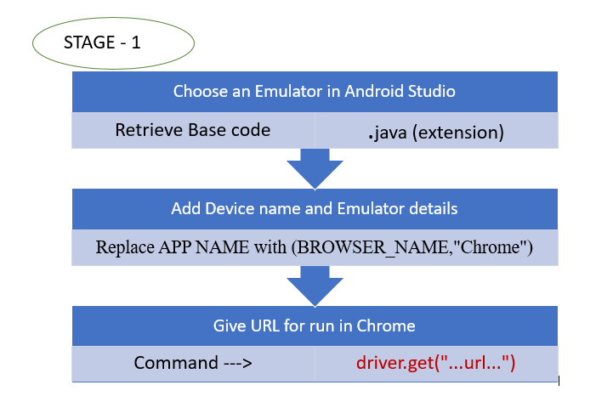
FLOWCHART

Slide 6
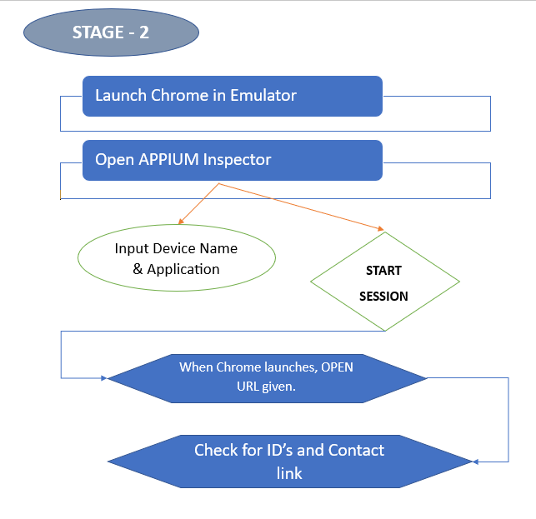
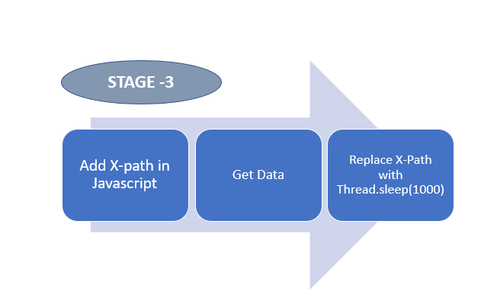

Slide 7
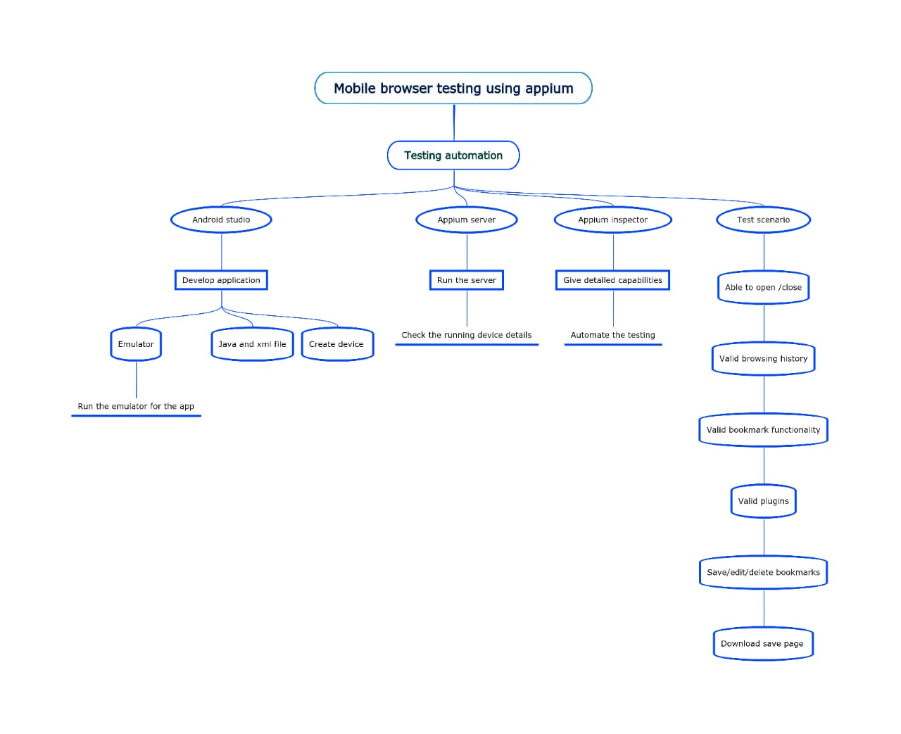
CONCEPT MAP

Slide 8
TEST CASES
Able to open, close, maximize, minimize browser tabs.
Able to navigate to a website.
Navigate forward / backword menu able to refresh / reload the page
Validate browsing history
Validate look and feel of all ui elements, font size, colour, css
Validate it loads all images, video,
Validate plugins (add , delete plugins)
Validate bookmarks functionality
Save / edit/ delete bookmarks
Validate browser able to load applications of all front end programming languages (php, javascript, html, react js, node js)
Settings
Download, save page

Slide 9



APP TOOLS AND INSTALLATION
Android Studio
Appium Server
Appium Inspector

Slide 10
INSTALLATION
Download Android Studio
Install SDK in Android Studio
Download Emulator in Android Studio
Download Appium Inspector

Slide 11
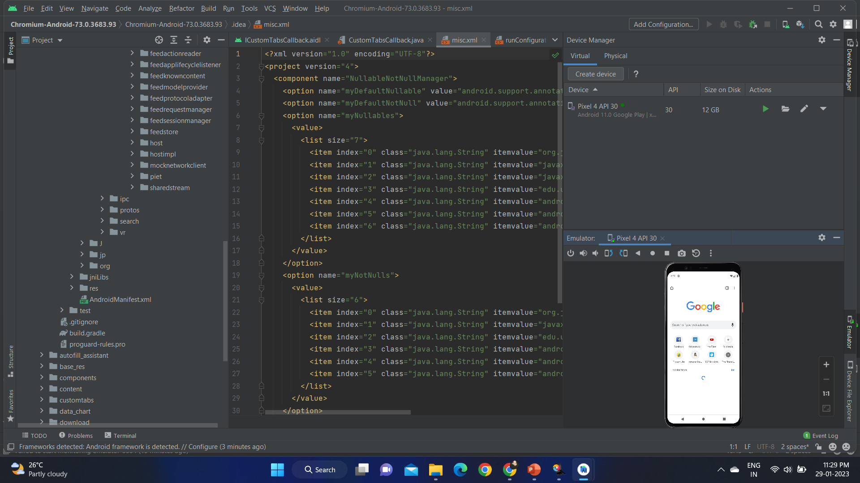
IMPLEMENTATION

Slide 12
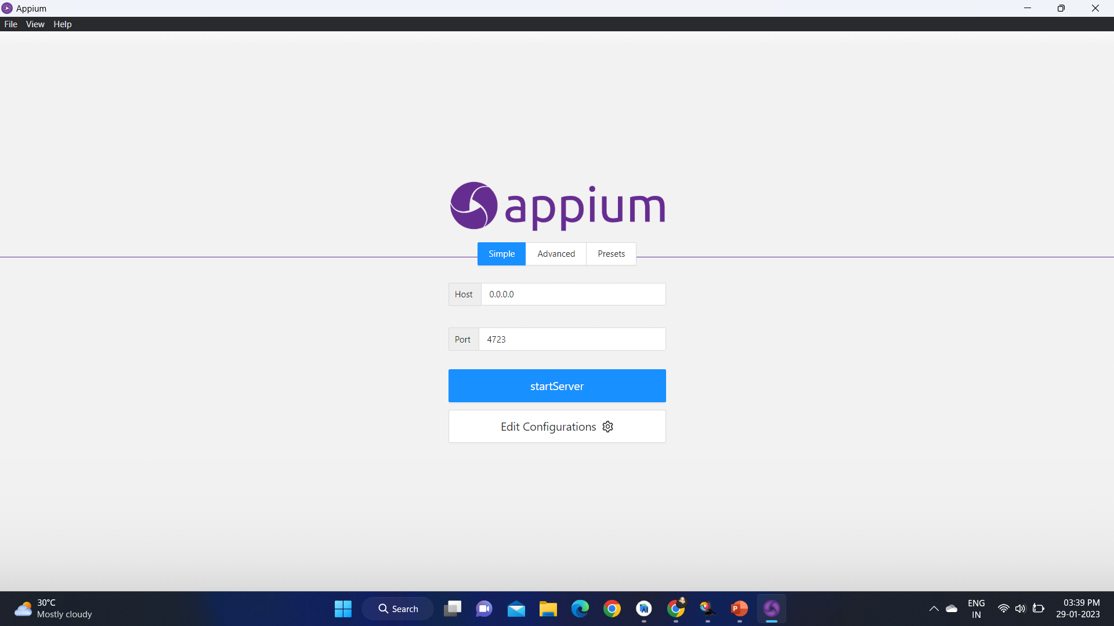

Slide 13
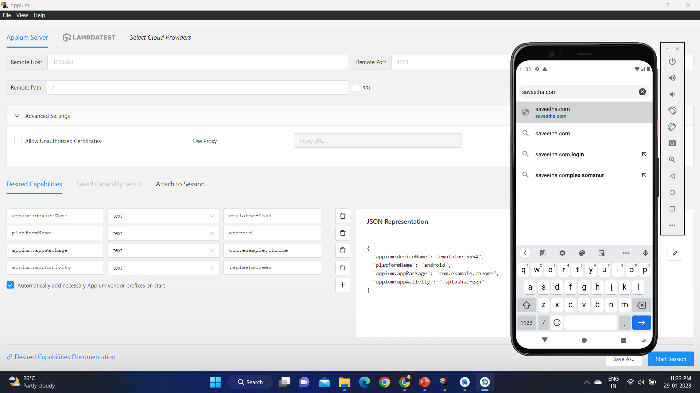
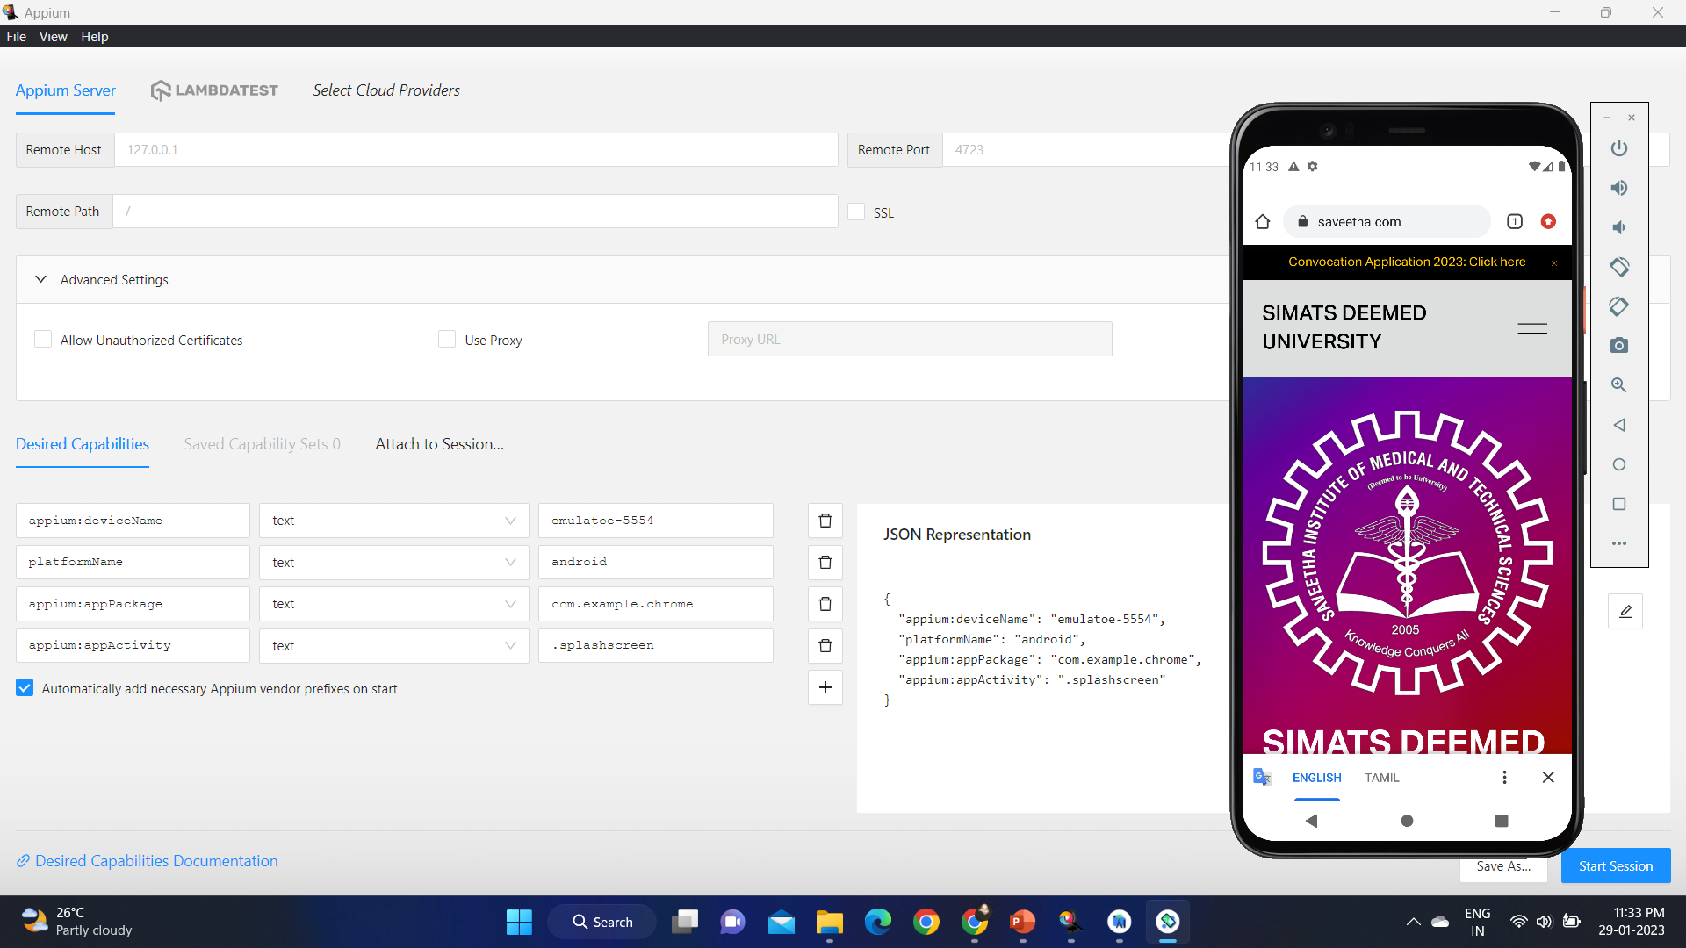

Slide 14
TESTCASE OUTCOMES
TESTCASES | POSITIVE/NEGATIVE
Verify if it is able to open, close, maximize, minimize browser tabs. | POSITIVE
Verify if it is able to navigate to a website. | POSITIVE
Verify if it is not able to navigate to a website. | NEGATIVE
Validate browsing history. | POSITIVE
Validate it not loads all images, video. | NEGATIVE
Validate bookmarks functionality. | POSITIVE
Verify if it is not able to save / edit/ delete bookmarks. | NEGATIVE
Verify if it is able to refresh / reload the page. | POSITIVE
Verify if it is able to download, save page. | POSITIVE

Slide 15
CONCLUSION
We developed Chrome application using android studio.
And the testcases of this application have been tested successfully using Appium server and Appium inspection which has the positive and negative test outcomes.

